Slide 1
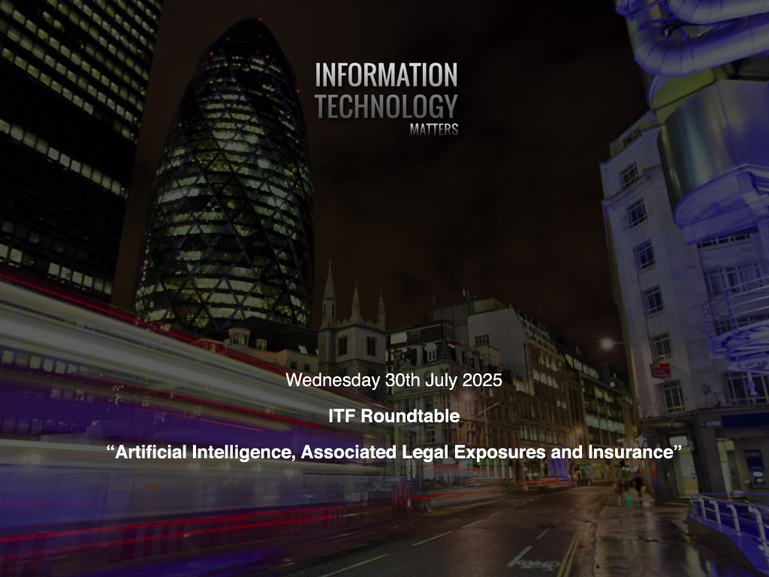

Slide 2


You, me and AI
Des O’Connor
30th July, 2025

Slide 3

The AI Era
Applying AI to your most impactful processes, in
your most important areas, to improve your
organisation
2 Copyright © Dell Inc. All Rights Reserved.

Slide 4
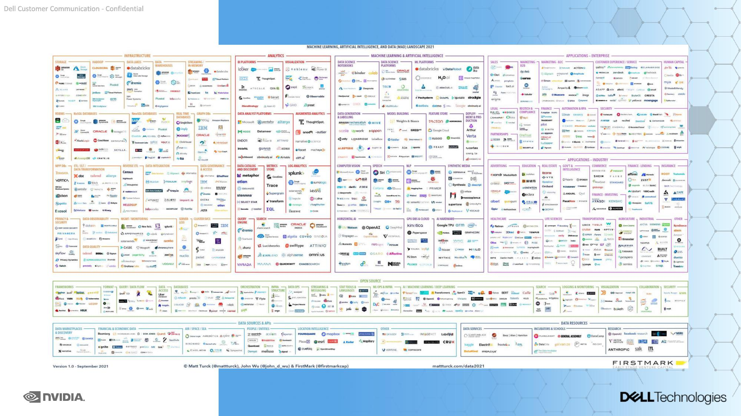
Chaotic AI Landscape (2021)

Slide 5
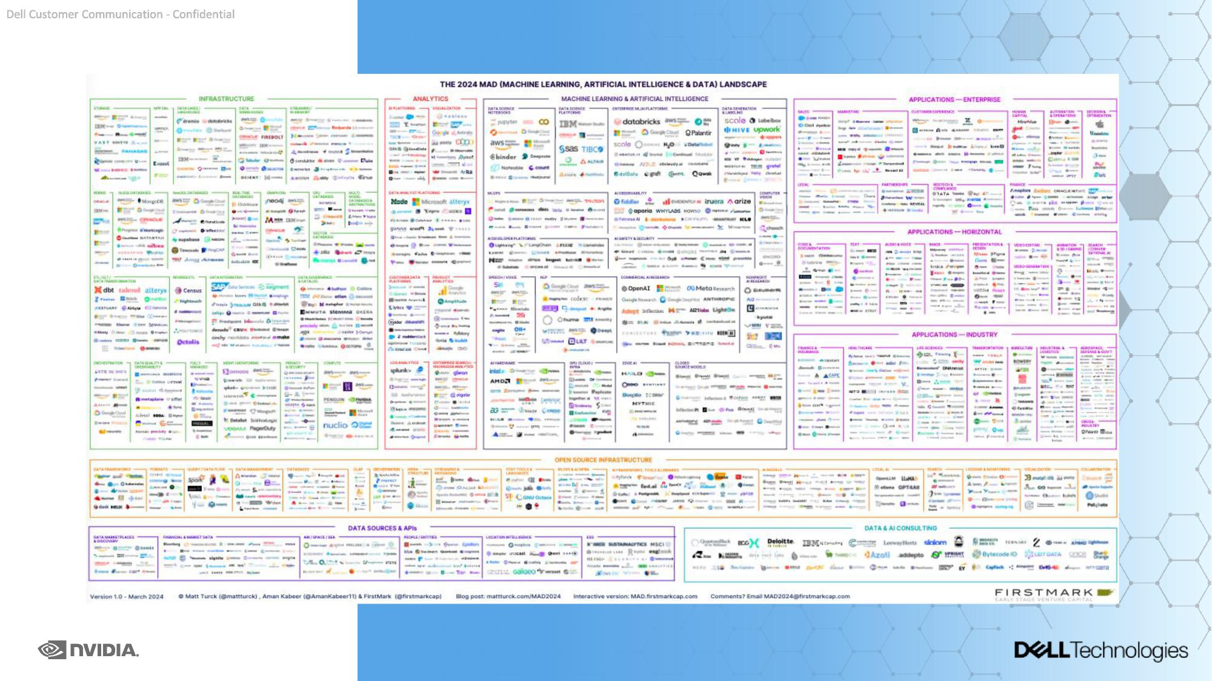
Chaotic AI Landscape (2024)

Slide 6

The importance of...
Data
"Data is the DNA of modern life and quietly drives every aspect of our society and economy without us even noticing
It has the enormous potential to make our lives better”
UK Technology Secretary Peter Kyle

Slide 7


It’s far more efficient and effective to: bring AI to the data AI models need to access data where it lives and where it is created. Moving data sets creates risk, complexity and the potential for added costs.
78%
42%
prefer a primarily on-
say they are ready for the bulk of the data to come from the edge in the next five years. [1]
premises or hybrid
GenAI model [1]
1. Innovation Catalysts study, Dell Technologies, February 2025, Dell.com/InnovationCatalyst
6 Cprighoyt © Dlel ncI. All ightRs eeredRsv.

Slide 8
The AI journey starts with two critical questions
Q. Q.
What problem How
are you solving do you
with AI? do it?
7 Copyright © Dell Inc. All Rights Reserved.

Slide 9
Answers lead to next steps in the AI journey
Q. Q.
What problem How
are you solving do you
with AI? do it?
What makes There is no AI without data.
you special? Create a strong foundation.
What process is going Use patterns in use cases to
to move the needle? identify foundational tools
What AI solution could Build vs buy? solve this problem?
8 Copyright © Dell Inc. All Rights Reserved.

Slide 10

The Dell AI Factory
Dell’s approach to help customers embrace and implement AI
DATA SERVICES
USE CASES
USE CASES
Strategy Data Platform Use case Operate & scale
Algorithm Decisions
Content & code generation
Digital assistant
Data creation
Computer vision
Digital twins
Edge
OPEN ECOSYSTEM
Automated Claims & Fraud Detection
Data center
Real Time Risk Assessment
Applications
Models Solutions Frameworks & tools
INFRASTRUCTURE
Client Personalisation through Analytics
Cloud
Regulatory Compliant & Automated Audits
Client devices Compute Storage Data Protection Networking Software
... and more
... and more
9 Copyright © Dell Inc. All Rights Reserved.

Slide 11

3 Steps to building the AI Enterprise
Step 1:
Build a clear understanding of what you want to accomplish
Step 2:
Defend your competitive advantag
e
Step 3:
Develop governance frameworks
0 Cprighoyt © Dlel ncI. All ightRs eeredRsv.

Slide 12

Attributes that influence use cases
Use enterprise Data?
Data science patterns
AI Level
Business process
Guardrails
Implementation
No
Yes
Pre-trained/RAG
Fine-tuning/creation
Less autonomous
More autonomous
Less customer-facing
More customer-facing
Less strict/less risk
More strict/more risk
At the edge
Agent
Knowledge workers
Customer facing Digital/data center
11 Cprighoyt © Dlel ncI. All ightRs eereRsvd .

Slide 13


Demystifying AI
30 July 2025
Version 1.1
Prepared for: ITF Roundtable

Slide 14

“He’s not the Messiah…”
Source: Monty Python’s The Life of Bryan, 1979
“…He’s a very naughty boy!

Slide 15

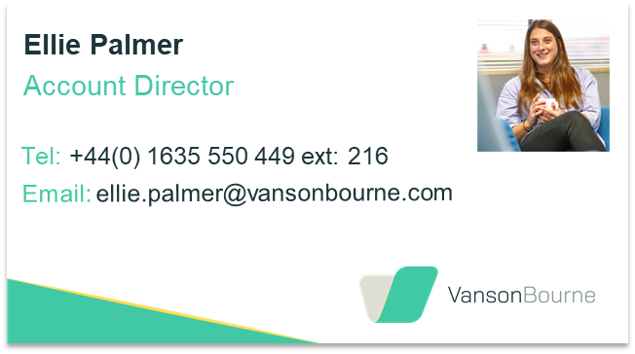




About me
Fraser Pearce
Head of Vendor/Strategic
Partnerships
Tel: +44 7784 206 843
Email: fraser.pearce@vansonbourne.com
Research Director / VP
www.linkedin.com/in/fraser-h-pearce
Mathematics (MA)
Stronger insights. Smarter strategy.

Slide 16


















About Vanson Bourne
End-to-end service and support
Consultative approach
Technology research expertise
Total Quality Management
Professional, insightful deliverables
Global reach

Slide 17
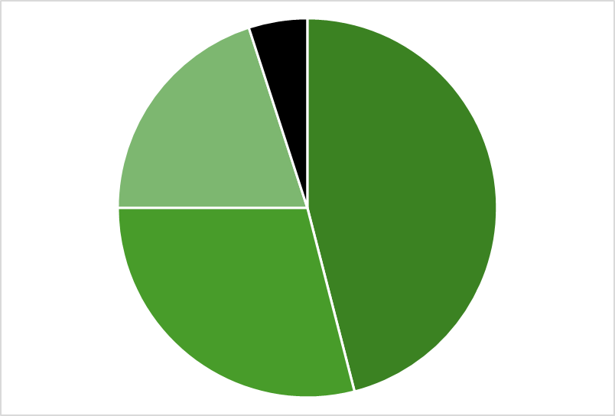
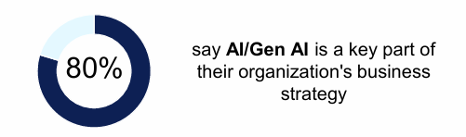
Question 1: AI, Revolution or Evolution?
Chill out, AI is “not new”…
Artificial Beings were imagined by the Greeks
“Machine Learning” dates back well over 50 years
But, the pace of change is accelerating
Flavours of AI…
Most important type of AI project in my organisation
Other AI
Generative AI
Agentic AI
But the human-machine interface (e.g. “GPT’s”)… …now there’s a revolution
All data here is from Dell’s GDPI (Global Data Protection Index), compiled by Vanson Bourne. A study of over 3000 IT Decision Makers in 40 countries

Slide 18
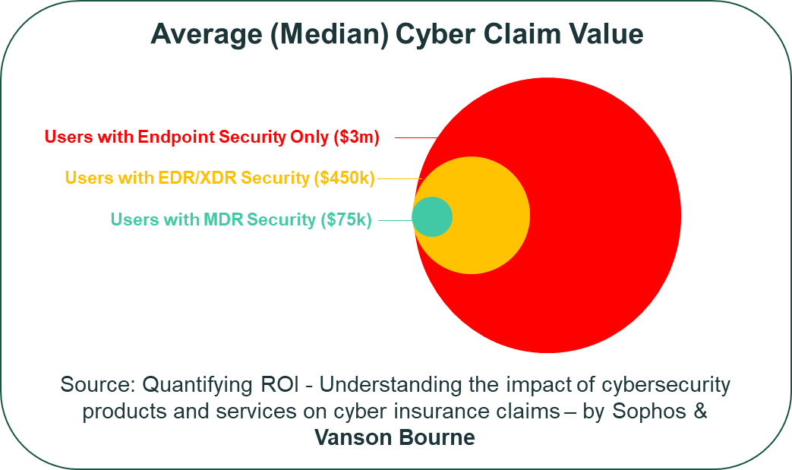
Quesiton 2: AI, friend or foe?
The “foe” argument(s)
The “friend” argument
AI (especially Agentic AI) is “widening the attack surface” for most businesses
Using AI can mean handing over sensitive data/IP, often to “cloud-based” vendors

Slide 19
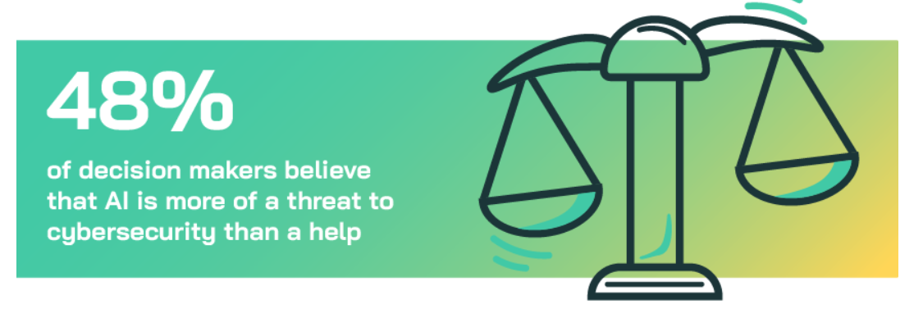
Let’s Vote…
“Survey says”… Friend 52 : 48 Foe
Data is from Vanson Bourne’ AI Barometer March 2025

Slide 20

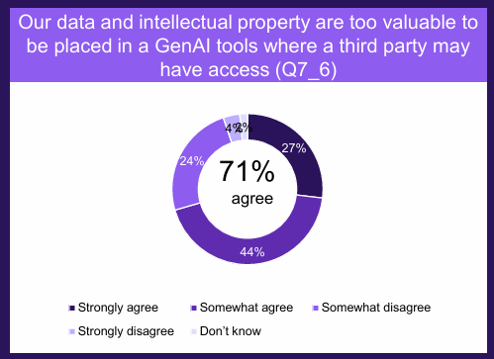
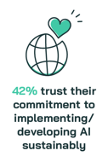
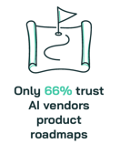

Question 3: AI, Lacks Trust… …Needs Regulation?
Data is from Vanson Bourne’s AI Barometer, April 2025 (except purple chart = Dell GDPI)

Slide 21
So, what about insurance?
AI is not really “anything new” (it’s just a lot of clever things bolted together)
We’ve not seen any completely new risk categories emerge, yet
But the proliferation of AI (Generative & Agentic) will amplify exposure to:
IP rights/theft, defamation, etc
GDPR, privacy & “data sovereignty”
Business continuity, disaster recovery & cyber resilience
Compliance
Employment law
Risks only large enterprises have been exposed to will increasingly be felt by everyone (down to SMEs & sole traders)

Slide 22
Don’t hesitate to get in touch with questions!...
Fraser Pearce
Head of Vendor/Strategic
Partnerships
Tel: +44 7784 206 843
Email: fraser.pearce@vansonbourne.com
www.linkedin.com/in/fraser-h-pearce
Stronger insights. Smarter strategy.

Slide 23
AI presentation
30 July 2025
Nick Gibbons
Legal Drector
Clyde&Co

Slide 24
Artificial intelligence is not "cyber"
Artificial intelligence and "cyber" are not synonymous.
The word "cyber" describes issues and events on the internet and computer networks connected to it. The internet is a means of communication and an information store that can be searched.
AI is the field of computer science focused on creating machines or software that can perform tasks that typically require human intelligence.
In 1950 Alan Turing published "Computing Machinery and Intelligence" and proposed the Turing Test.
1955, John McCarthy, a Professor of Mathematics at Dartmouth College, decided to organize a group to clarify and develop ideas about thinking machines. He picked the name 'Artificial Intelligence' for the new field.
Why does this matter?

Slide 25
The impact of AI in legal terms – all the time in the world?
AI technology and the use of the technology seems to be running way ahead of specific new law and regulation
AI activities are already covered by existing non AI specific law
Significant scope for organisations and individuals to break existing law and regulation because they don’t understand and may not even have considered the interaction between AI and existing law.
In some ways new AI legislation is a distraction and red herring-t creates the imprssion of an unregulated wild west whereas in reality AI is covered by well tro
dden existing law.
EU AI Act
UK Approach to new regulation
US approach to new regulation
Existing law

Slide 26
What is the EU Act actually about?
The EU AI Act regulates conduct by prohibiting certain AI practices that pose unacceptable risks to fundamental rights, safety, and democratic values. Specifically, it bans:
Manipulative or deceptive AI that distorts human decision-making using subliminal techniques.
Exploitation of vulnerabilities (e.g. age, disability, socio-economic status) to influence behavior in harmful ways.
Social scoring systems that evaluate individuals based on behavior or traits, leading to unjustified or disproportionate treatment.
Predictive policing AI that assesses the likelihood of someone committing a crime based solely on profiling or personality traits.
Emotion recognition in workplaces or schools, and biometric categorization based on sensitive characteristics.
Scraping facial images from the internet or CCTV for identification purposes

Slide 27
And in the UK ?
The UK Government’s AI Playbook (updated in 2025) promotes a non-statutory, principles-based approach to AI governance. It emphasizes:
Safe and responsible use of AI across public services.
Ethical considerations, including fairness, transparency, and accountability.
Societal wellbeing and public good as guiding values.
Risk management and AI quality assurance.
Collaboration with academia, industry, and civil society 1
.
This framework is designed to be flexible and adaptive, allowing departments to tailor AI use to their specific contexts while adhering to shared principles.

Slide 28
New AI legislation –a red herring?
AI legal risks are already governed by existing laws :
Contract
Liability Mistakes
Bias and Discrimination
Privacy
IP Infringement
Lack of Transparency Employment & Automation Law

Slide 29
Everybody is doing it
Businesses of every sort are making increasing use of AI for efficiency, economy and speed:
Healthcare
Law
Software Development & IT
Finance & Banking
Marketing & Sales
Creative Professions (Design, Writing, Art)
Education & Research
Engineering & Manufacturing

Slide 30
AI in insurance policies
Secret AI and Secret Cyber
"AI and secret AI" in insurance policies share only some of the same triggers and characteristics as "cyber and secret cyber""
Today's Cyber policies have their roots in privacy issues and law
“Cyber” claims are usually concerned with personal data breaches and business interruption claims resulting from a ransomware attack and/or an insured’s carelessness and/or inadequate computer network security
Secret cyber insurance occurs when such breaches are covered by broadly worded liability policies absent an applicable exclusion clause.
AI exposure can also arise from a personal data breach and/or inadequate information security but...
AI cover is much broader, not very "secret" in insurance terms and therefore potentially represents a much greater exposure for insurers

Slide 31
AI Risks for business
AI in the context of l business is a tool, and it is the person or firm using it to provide professional services if it creates and error in their advice or results in the firm infringing third party rights or breaking laws and regulations
It is that person or firm that will be covered by an insurance policy – not the AI software they are using – in legal and insurance terms an error made by AI is their error.

Slide 32
AI risk in an insurance policy
AI risk in an insurance contextbroader than cyber risk and cover and is likely to include :
Breach of contract
negligence;
negligent misstatement or negligent misrepresentation;
breach of a duty of care or confidence including any misuse of information which is either confidential or subject to statutory restrictions on its use;
infringement of intellectual property rights (including copyright, trademark, design, title, slogan or moral rights) or any act of passing off;
libel or slander;
breach of professional duty generally.

Slide 33
“SMEs – a minefield?
99 % of businesses in UK are SMEs
Many SMEs are now using AI for everything they do: research, marketing, videos, websites, Instagram reels and accounts.
…............without properly checking the results.
Many of people in an SME , administrative or charity context do not properly understand information assets and laws : defamation; intellectual property; trade secrets and confidential information.
AI will process information assets and produces results in seconds and may cross many lines in the process.
Who can or will check what it produces – probably not the data protection officer, director or senior administrator.

Slide 34
Existing cyber exclusion clauses won’t bite and there is precious little in proposal forms
Proposal forms don’t generally ask the right questions - and cyber questions are not relevant to most AI risks
AI risks are likely to be covered because AI iis a tool – it’s the human being or business using it that is legally liable and therefore “the insured”
Most computer/cyber exclusion clauses are intended to exclude liability for viruses and data breaches caused by hackers.
These clauses won't exclude liability for unreasonable reliance on AI solutions.
Very few policies incorporate exclusion clauses covering AI risk.
The caselaw on unreasonable reliance on AI is still in its infancy.
A fortiori existing policies are very unlikely to be construed as not covering AI risk unless there is a specific AI exclusion clause.

Slide 35
Thank you. Any questions?
Nick Gibbons
0207 457 3567
Nick.gibbons@clydeco.com

Slide 36
AI and Lawyers
HELEN EVANS KC
July 2025

Slide 37
AI isn't new, but two recent cases show the pitfalls
Ayinde v Haringey LBC [2025] EWHC 1040 (Admin): wasted costs
Ayinde v Haringey LBC & Al-Haroun v Qatar National Bank QPSC [2025] EWHC 1383 (Admin): contempt of court
What lessons can be learned?

Slide 38
Where court rules and AI may collide- witness evidence
Generating drafts?
Transcribing meetings?
Preparing materials?

Slide 39

Where AI and court rules have worked- disclosure
Lessons from TAR Reviews (predictive coding)
TAR endorsed by the courts-
But transparency and oversight required-
Plus ability to go back to human process.

Slide 40
AI and clients
Limiting the scope of the retainer
Extreme cases such as “Garfield law”
Use of AI to do tasks usually done by people
Disclosure to clients
Use of client data
“Extreme” confidentiality warnings in SRA/BSB and Judicial Guidance and widely available tools
Hacking risk

Slide 41

Professional guidance on the use of AI in legal practice
Solicitors Regulation Authority, “Risk Outlook report: the use of artificial intelligence in the legal market”, 20 November 2023.
Bar Council, “Considerations when using ChatGPT and generative artificial intelligence software based on large language models”, 30 January 2024.
Courts and Tribunals Judiciary, “Artificial Intelligence (AI), Guidance for Judicial Office Holders”, 14 April 2025.
Direction of travel? RICS draft Guidance- “Responsible use of AI in Surveying Practice”, March 2025

Slide 42
Professional guidance on the use of AI in legal practice
Solicitors Regulation Authority, “Risk Outlook report: the use of artificial intelligence in the legal market”, 20 November 2023.
Bar Council, “Considerations when using ChatGPT and generative artificial intelligence software based on large language models”, 30 January 2024.
Courts and Tribunals Judiciary, “Artificial Intelligence (AI), Guidance for Judicial Office Holders”, 14 April 2025.
Direction of travel? RICS draft Guidance- “Responsible use of AI in Surveying Practice”, March 2025

Slide 43
hm.evans@4newsquare.com
ADDRESS
  4 New Square Chambers
  Lincoln's Inn
  London
  WC2A 3RJ
CONTACT
  +44 20 7822 2000
  clerks@4newsquare.com

Slide 44


